Slide 1

CS 6476: Computer Vision
Instructor: Frank Dellaert Tas: Sergio Aguilera (head TA), and Arvind, Ayush, Sen, and possible a few more hires soon…
Image by kirkh.deviantart.com

Slide 2
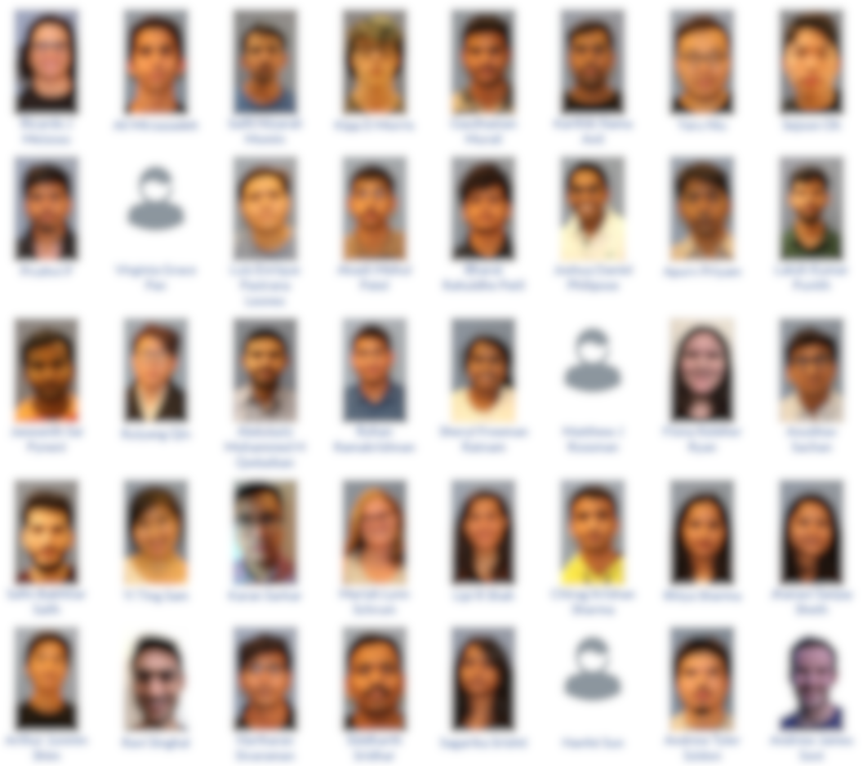
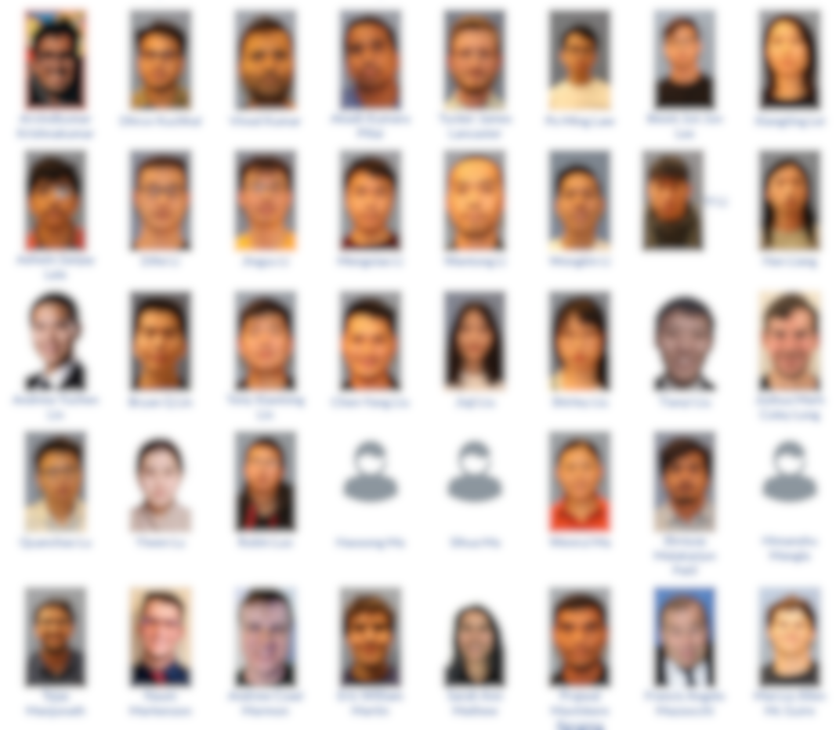
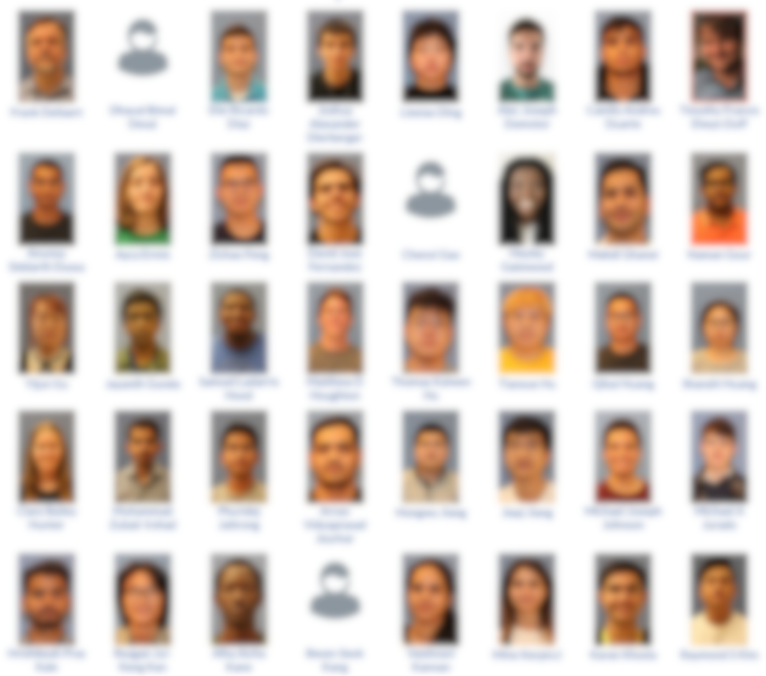
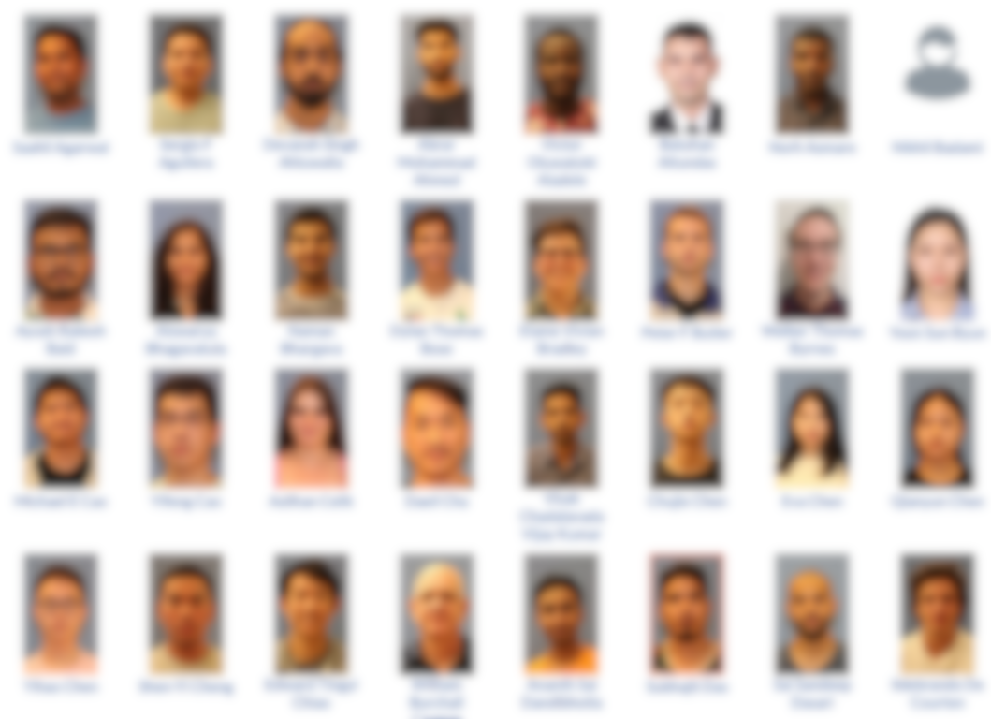
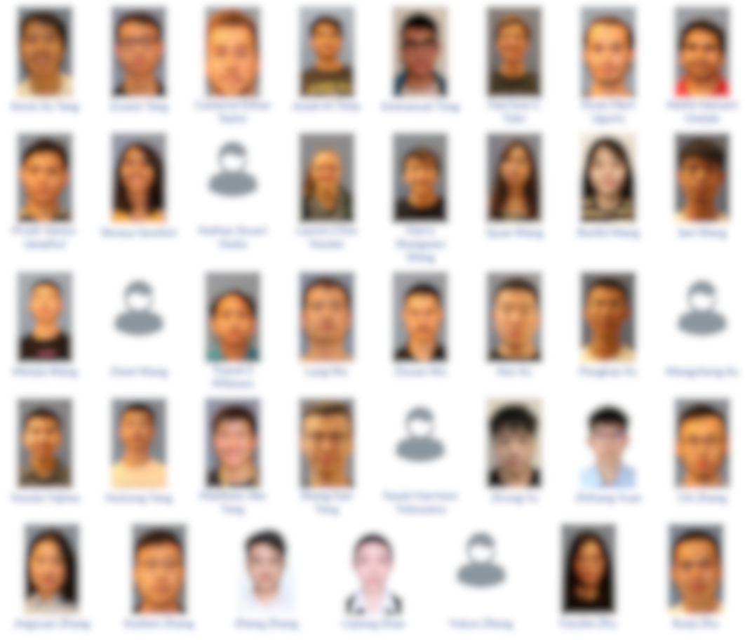
And almost 200 of you!

Slide 3
Today’s Class
Who are we?
Specifics of this course
What is Computer Vision?

Slide 4
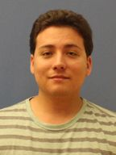
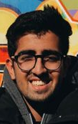
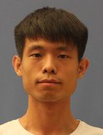
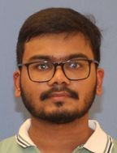
Teaching Assistants
Sergio Aguilera
Sen Wang
Ayush Rakesh Baid
Arvind Krishnakumar

Slide 5
A bit about me
https://dellaert.github.io/
Originally from Belgium
1989 EE in Leuven
1993 M.Sc. ECE at CWRU
2001 Ph.D. CS, Carnegie Mellon
Georgia Tech since August 2001
Teaching Computer Vision etc.:
7641 | Machine Learning | 02, 03, 04 | 45
8803 | 3D Reconstruction and Mapping | 02, 09, 10,12 | 70
4495 | Computer Vision, undergraduate | 04, 05, 06, 07, 19 | 278
8803 | Intro to Perception and Robotics | 05, 06, 07,13,14, 20 | 485
7495 | Computer Vision, graduate | 06, 07, 11, 12, 13, 20 | 353
4475 | Computational Photography | 07, 09, 18 | 155
4480 | Digital Video Special effects | 08, 09, 10, 11 | 146
 |  |  | 1432

Slide 7
A bit about me

Slide 8

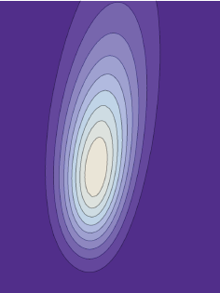
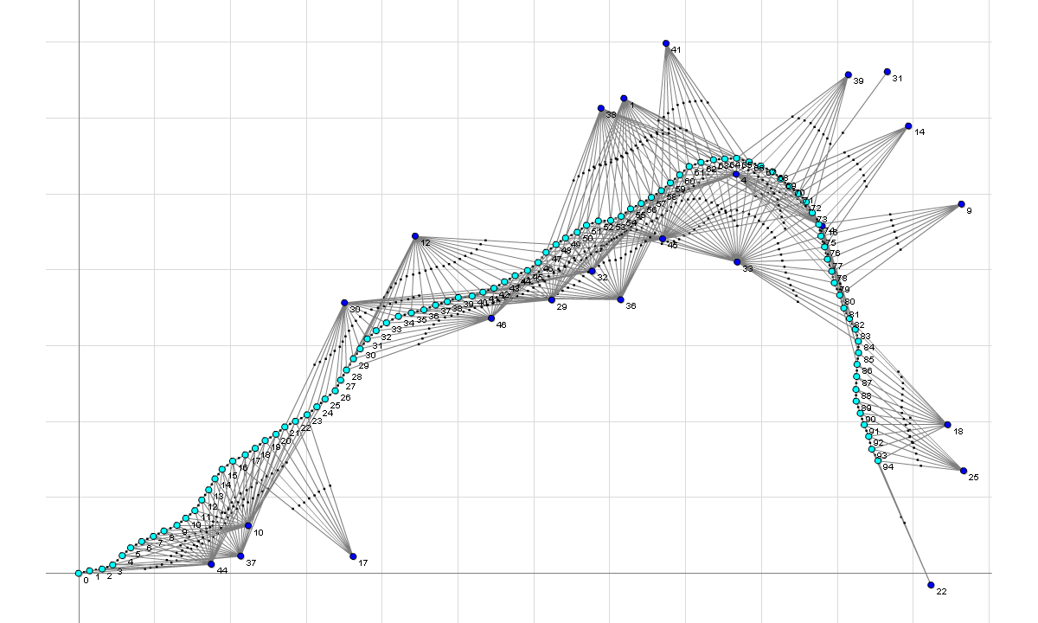
Factor Graphs -> GTSAM !
Factor Graphs and AD for Flexible Inference in Robotics and Computer Vision, © 2008-2018 Frank Dellaert
Notes:
The associated factor graph, as imported in mfqr

Slide 9
Silicon Valley intermission at Skydio

Slide 10

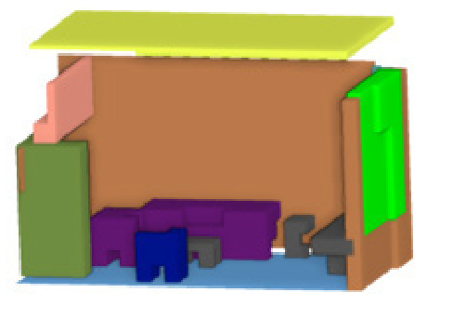
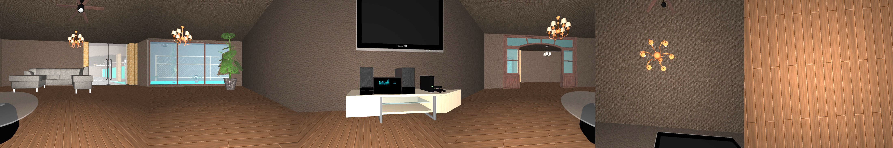

The Scene Understanding and Modeling Challenge
Silicon Valley intermission at Facebook
Color
Depth
RGB-D 360 degree image
Object-based representation of a room
Organizers
Daniel Huber (Facebook)
Lyne Tchapmi (Stanford University)
Frank Dellaert (FB / Georgia Tech)
Vision Problems Addressed
Object segmentation | 6-DOF pose estimation
Object completion | Appearance modeling
Instance labeling | Layout estimation

Slide 11

Silicon Valley engagement at Google AI

Slide 12
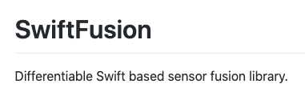

What’s next? Robot Art! Dynamics! SwiftFusion!
For-credit projects available for SwiftFusion

Slide 13
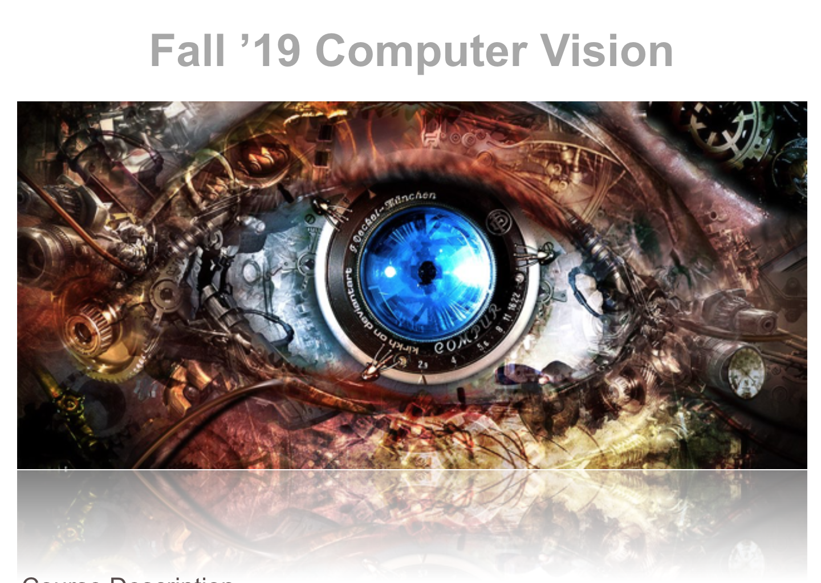
Course Website/Syllabus
https://dellaert.github.io/20F-6476/

Slide 14

Project 0: Linear Algebra with Pytorch
Out: 6.30 today
Due: September 1st, midnight
Late policy: 10% per day
Learning Objectives:
Set up a conda environment
Understand how to start a jupyter notebook
Linera algebra in python using pytorch
Test your code using unit tests
Use gradescope to submit your work

Slide 15
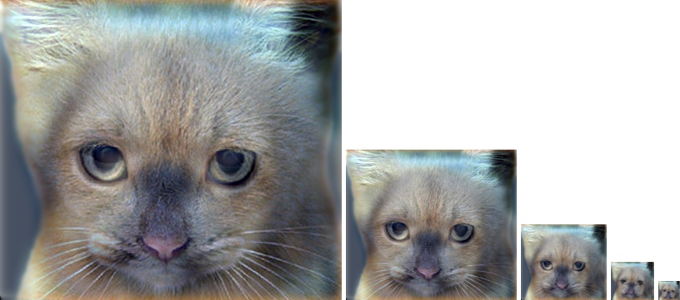
Project 1: Image Filtering and Hybrid Images
Implement image filtering to separate high and low frequencies
Combine high frequencies and low frequencies from different images to create an image with scale-dependent interpretation

Slide 16
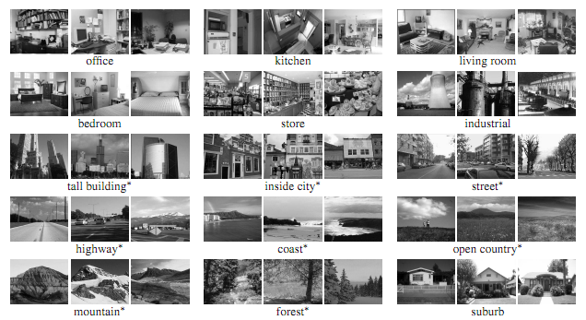
Project 2: Scene Recognition with Deep Learning
Learning Objectives:
Understanding the rationale behind data pre-processing
Construct a basic CNN for multi-class classification
Understand the use of some basic layers used in CNNS
Set up the training workflow in Pytorch.

Slide 17
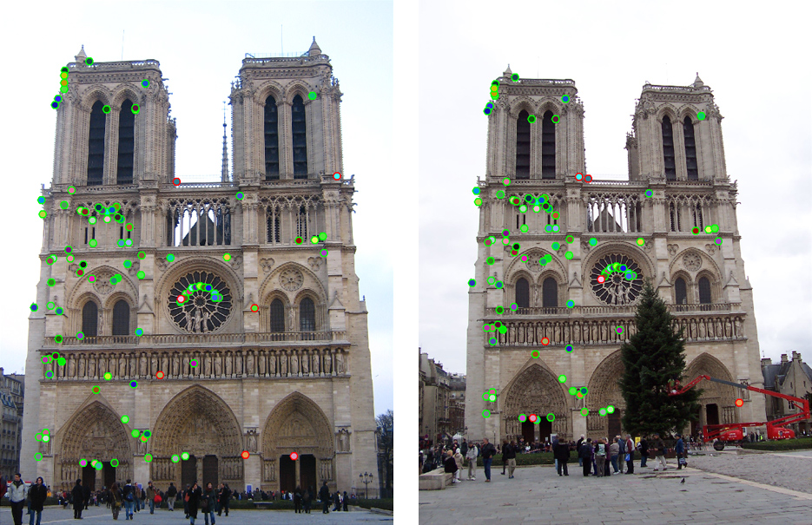
Project 3: Local Feature Matching
Implement interest point detector, SIFT-like local feature descriptor, and simple matching algorithm.

